Slide 1
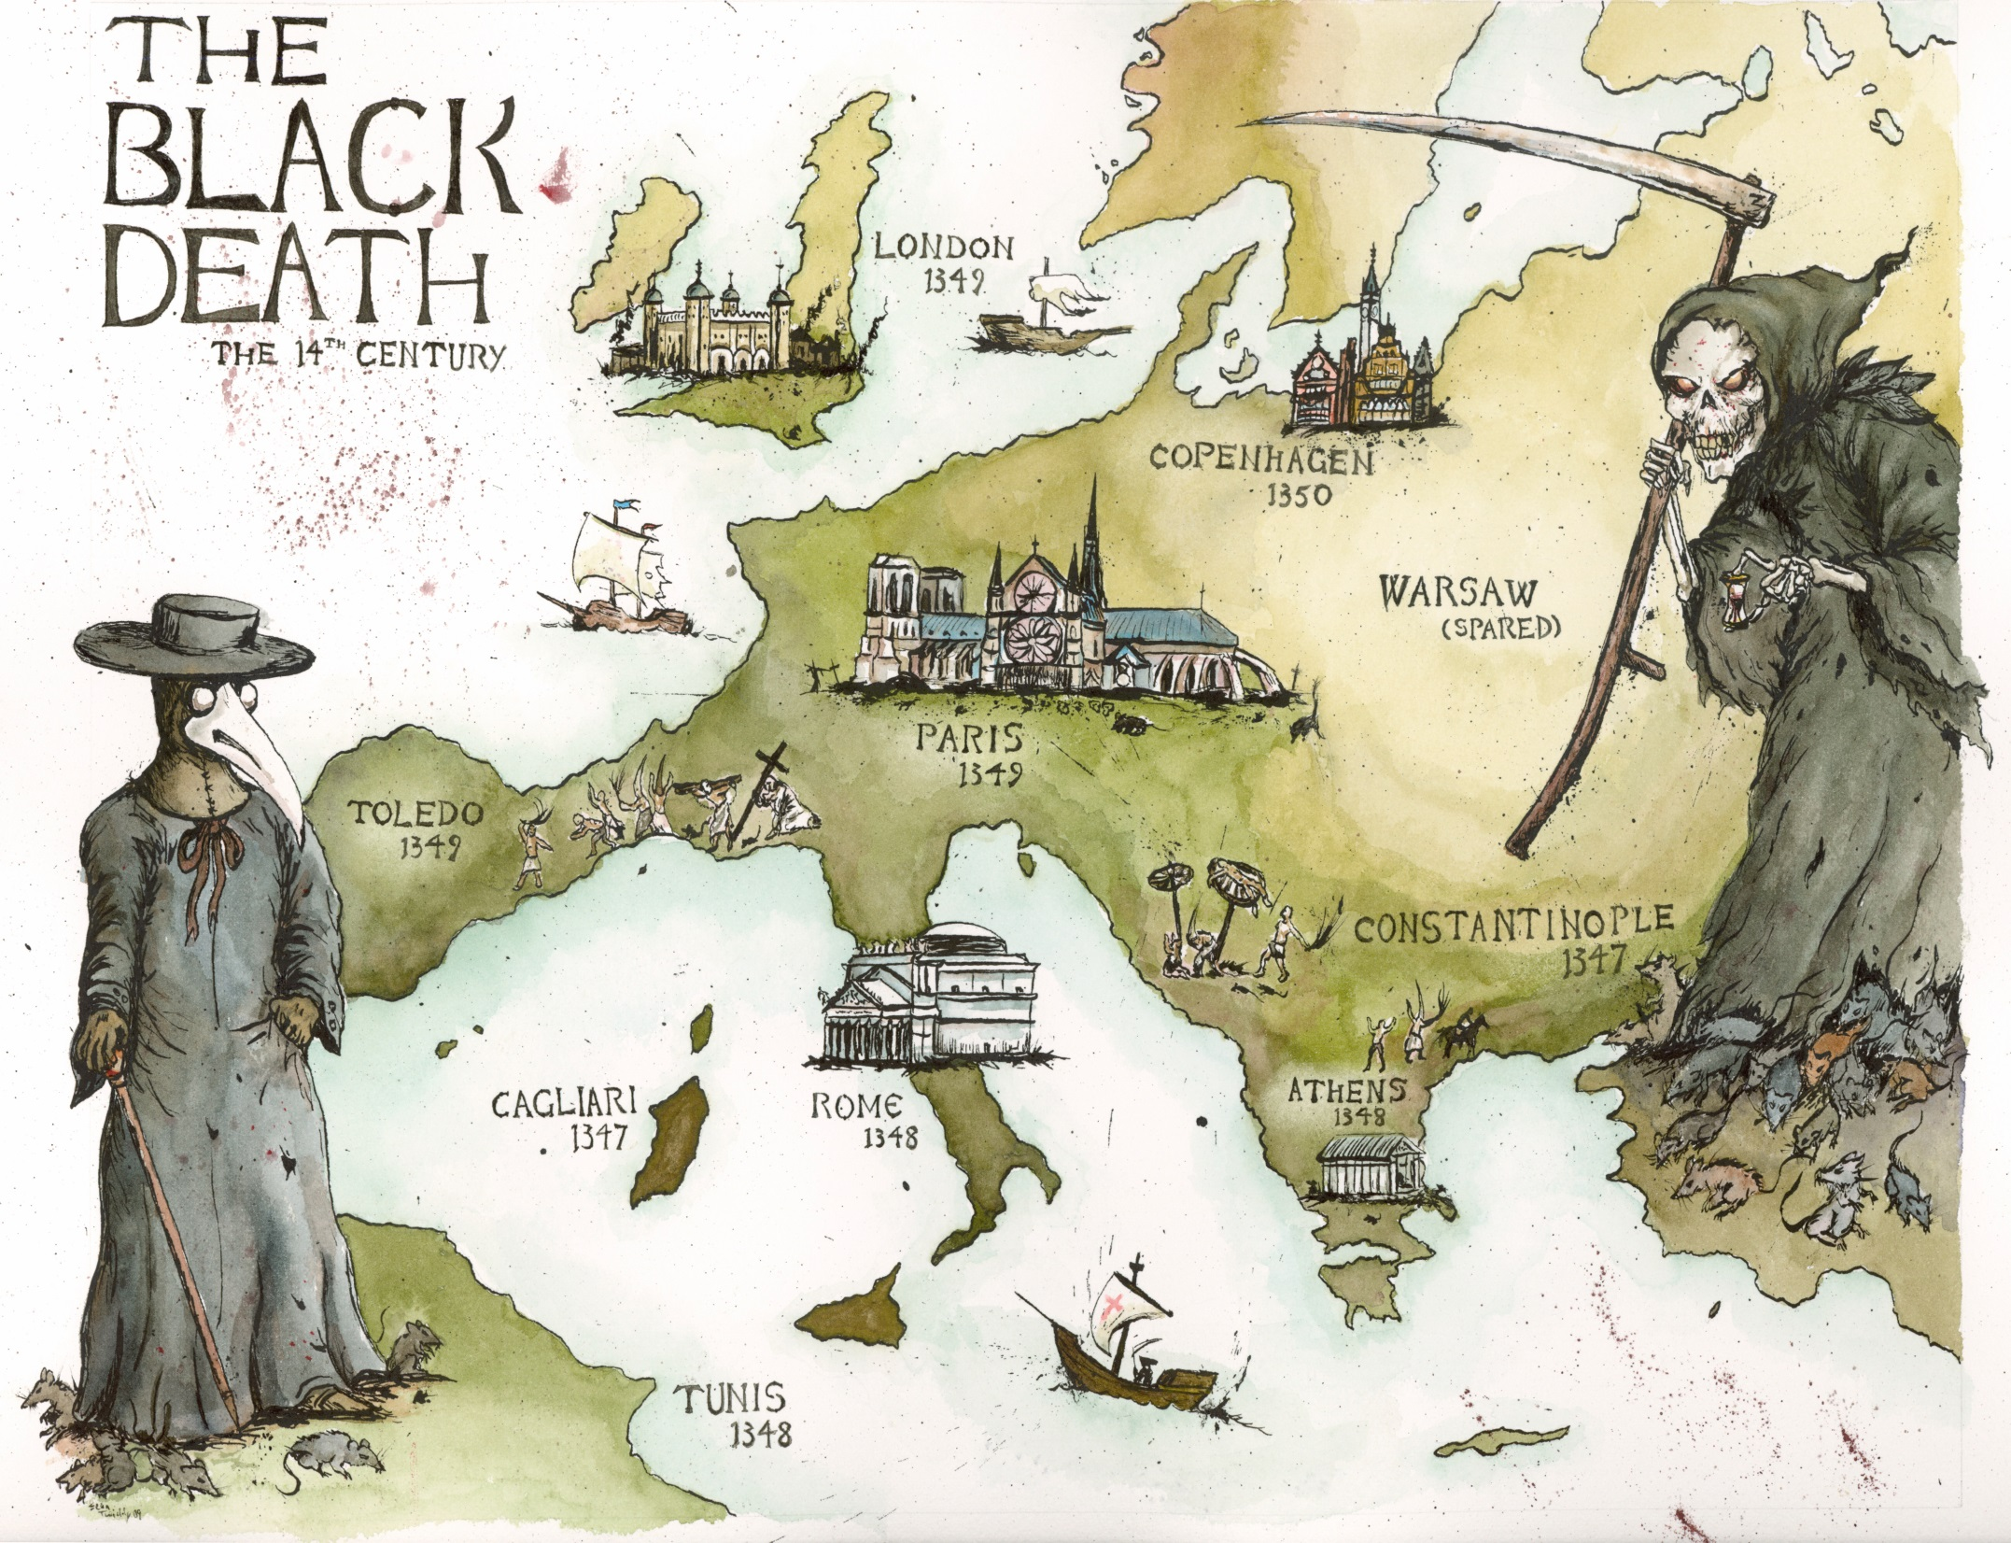

Slide 2
https://www.youtube.com/watch?v=ySClB6-OH-Q

Slide 3
Questions
What caused the Black Death?
The smallpox virus
The influenza virus
Bubonic plague bacterium
The tuberculosis bacterium
No one knows

Slide 4
Questions
What caused the Black Death?
The smallpox virus
The influenza virus
Bubonic plague bacterium
The tuberculosis bacterium
No one knows

Slide 5
How was the Black Death likely spread?
From person to person
By contaminated food
By mosquitos
By rats and their fleas

Slide 6
How was the Black Death likely spread?
From person to person
By contaminated food
By mosquitos
By rats and their fleas

Slide 7
The Black Death was the second major epidemic of its kind. What was the first known epidemic of the disease that also caused the Black Death?
a) The Plague of India
b) The Plague of Justinian
c) The Hong Kong Plague
d) The Antonine Plague

Slide 8
The Black Death was the second major epidemic of its kind. What was the first known epidemic of the disease that also caused the Black Death?
a) The Plague of India
b) The Plague of Justinian
c) The Hong Kong Plague
d) The Antonine Plague

Slide 9
What proportion of the affected population was killed by the Black Death?
Less than 10%
About 25%
Over 90%
About 50%

Slide 10
What proportion of the affected population was killed by the Black Death?
Less than 10%
About 25%
Over 90%
About 50%

Slide 11
When did the Black Death initially occur?
14th century A.D
19th century A.D
541 A.D
1904 A.D

Slide 12
When did the Black Death initially occur?
14th century A.D
19th century A.D
541 A.D
1904 A.D

Slide 13
How would you describe the population that existed right before the Black Death in terms of size, availability of food, and general health?

Slide 14
How would you describe the population that existed right before the Black Death in terms of size, availability of food, and general health?
large, not much food available, poor general health, affected by poverty, famine and disease

Slide 15
In what ways could the Black Death have led to improvements in health in surviving populations?

Slide 16
In what ways could the Black Death have led to improvements in health in surviving populations?
Improving the gene pool.

Slide 17
What has DNA analysis revealed about the Black Death?

Slide 18
What has DNA analysis revealed about the Black Death?
That it is the same strain as the modern strain prevalent today. People who died suffered from poverty, famine and poor general health.

Slide 19
What we will learn…
Origins
Symptoms and Causes
How it was spread – Trade Routes
Impacts on Society

